Slide 1
Effects of alcohol consumption in student life
Craciun Eugen Mihai
Iancu Robert
Melinte Tudor Matei

Slide 2
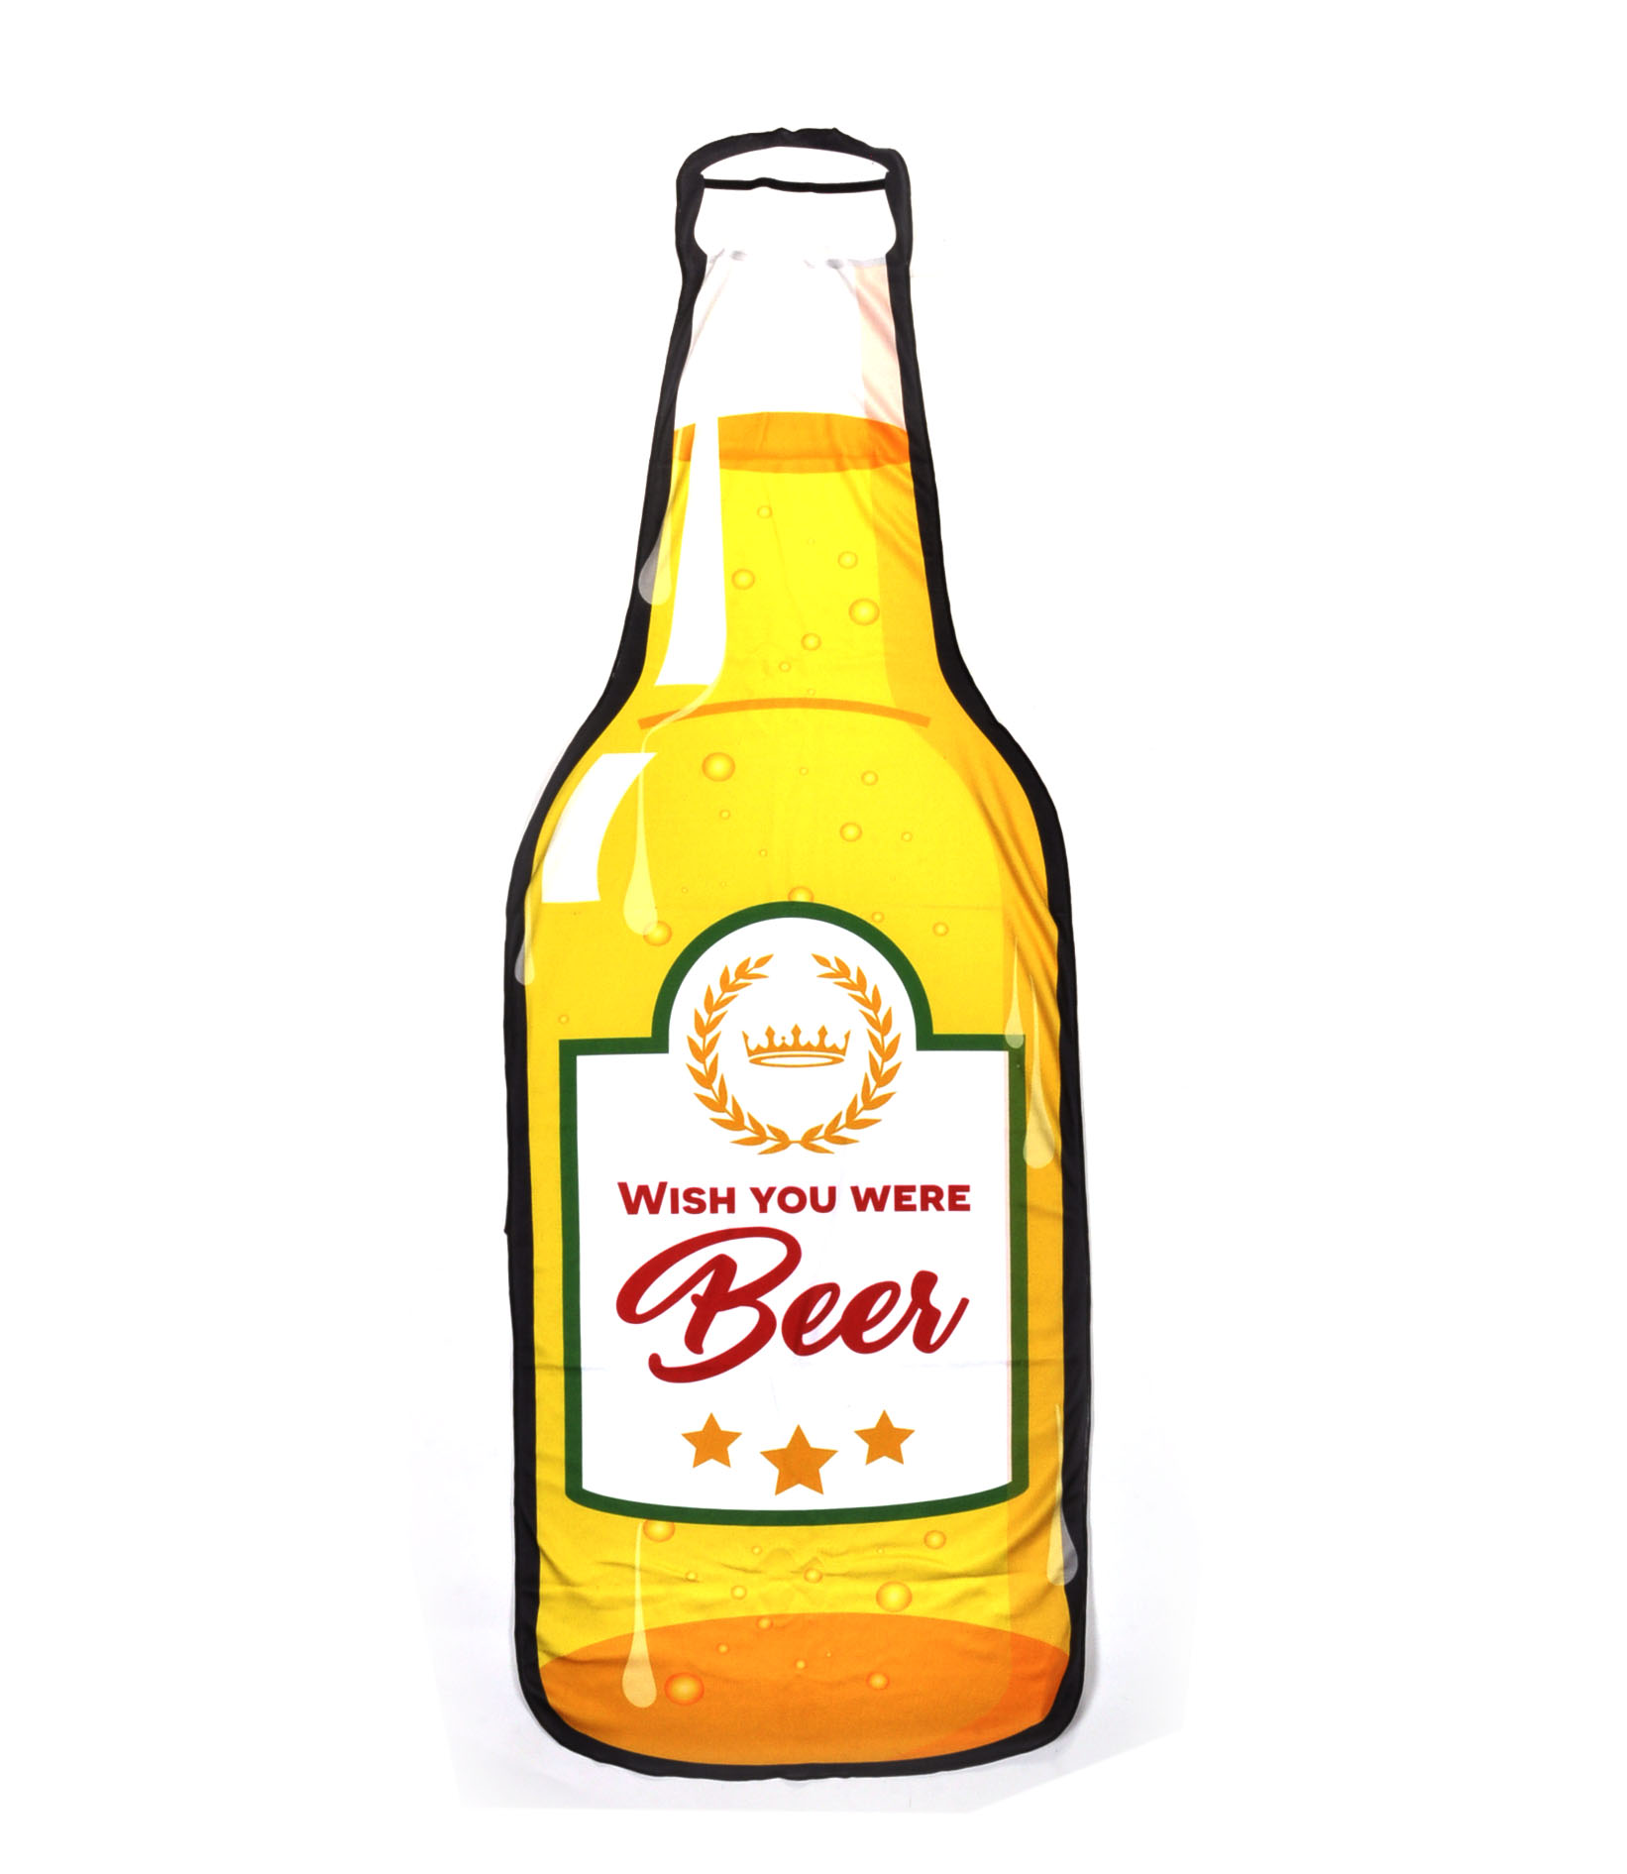
Motivation
We are students. Every student drinks alcohol in a certain amount. This is the period in our lives when we want to grow stronger and we want to learn more to become smart, independent individuals that succeed in their lives . This is why, after searching for an interesting topic, we decided to go with the Student alcohol consumption dataset.
https://www.kaggle.com/uciml/student-alcohol-consumption

Slide 3
What is our purpose?
Our purpose is to try to understand the data, hidden relationships between features, and answer questions like, how will my alcohol consumption affect my grades, does it affect them at all? How is the importance of other factors like family status, free time, age, sex, compared to the importance of alcohol in a student’s life.

Slide 4
The dataset
The data were obtained in a survey of students math and portuguese language courses in secondary school. It contains a lot of interesting social, gender and study information about students. It also contains the alcohol consumption during workdays and weekends.

Slide 5
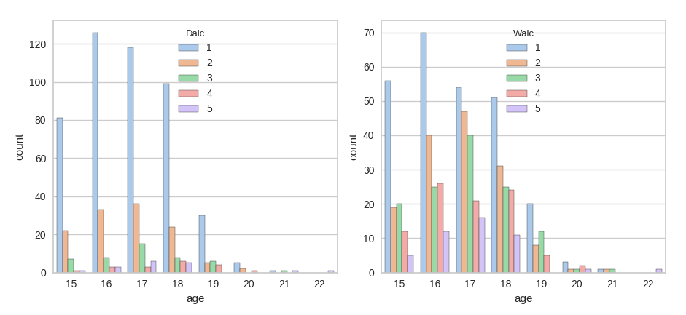
The dataset
Density distribution on ages for each alcohol consumption value

Slide 6
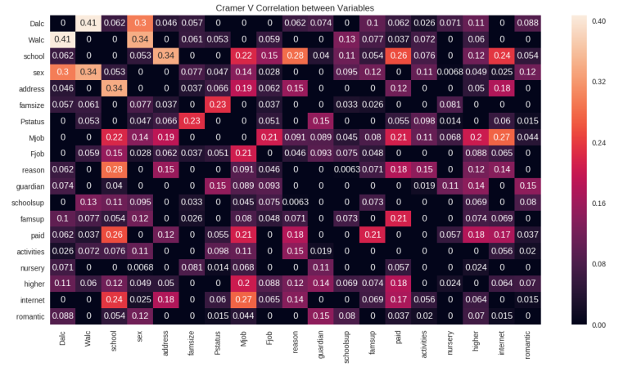
The dataset
Camér’s V Correlation highlights a lot of correlations between. The most noticeable correlations are between:
Dalc, Walc and student’s sex;
Address, reason and school;
Family size and parent's cohabitation status;

Slide 7
Alcohol consumption classification
In this part we will present how different features regarding school performance, family and social status are influencing the alcohol consumption of students. We are approaching this problem as a classification because our targets are “workday alcohol consumption” and “weekend alcohol consumption”.

Slide 8
Proposed Solutions
We have compared four machine learning algorithms: Logistic Regression, Random Forest, Nearest Neighbor, Support Vector Machine.
And five feature sets with different characteristics: All available features, Removing school attributes, Remove school attributes and grades info, Only family and social features, Only school performances.

Slide 9
Results
The best results were obtained when using all the features and the best performing model was Random Forest. Other good models were obtained when using only the family and social features.
Model | Score | Best parameters | Target
random_forest | 94.95% | n_estimators': 50 | Dalc
svc | 76.26% | C': 0.9, 'kernel': 'linear' | Dalc
knn | 71.72% | leaf_size': 5, 'n_neighbors': 12, 'p': 3 | Dalc
logistic_regression | 65.66% | C': 0.1, 'solver': 'lbfgs', 'tol': 0.0001 | Dalc
random_forest | 87.88% | n_estimators': 400 | Walc
logistic_regression | 54.04% | C': 0.1,'solver': 'lbfgs', 'tol': 0.0001 | Walc
svc | 51.01% | C': 0.6, 'kernel': 'linear' | Walc
knn | 46.97% | leaf_size': 5, 'n_neighbors': 6, 'p': 3 | Walc
Models trained using all the features

Slide 10
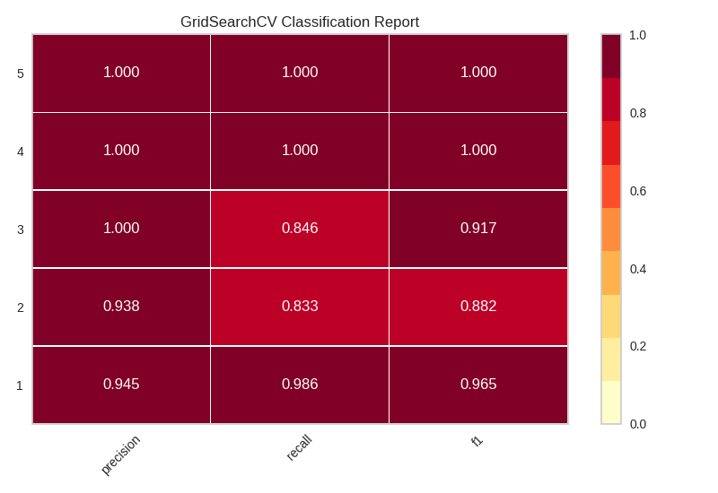
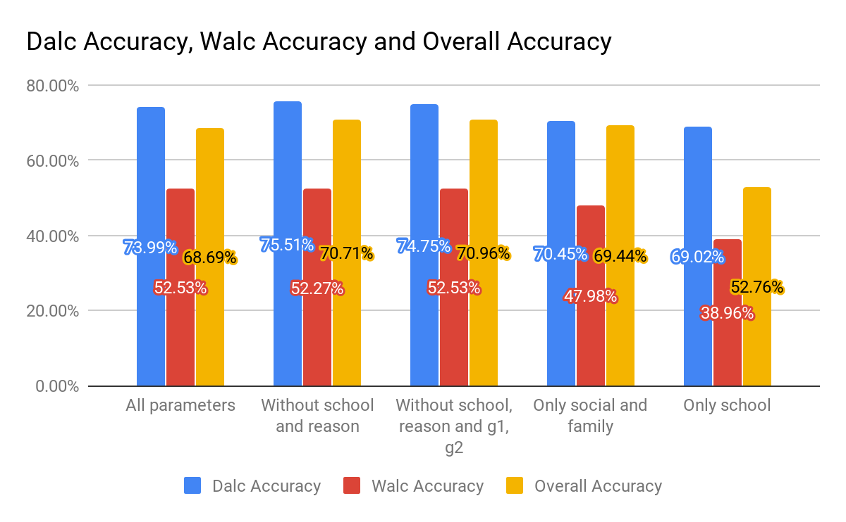
Results
Classification report of the random forest model with 94.95%
Overall Results

Slide 11
Grades regression
The direct professional bad impact which the alcohol consumption has on students are their grades. One helpful thing would be, given some background variables like parents status, age, parents education, alongside with the alcohol consumption, to be able to generate expected grades.

Slide 12
Proposed Solutions
We have compared three machine learning algorithms: ElasticNet, K Nearest Neighbours Regression, Random Tree Forest Regression.
And three feature sets: Predicting G3 using G1 and G2, Using all the features and Alcohol consumption (Dalc and Walc).

Slide 13
Results
The regression problem proved to be a more difficult one, but the results obtained were good. Best performing model was also Random Forest achieving an R2 score of 0.45.
Model | best_params | MAE | R2
Random Forest Reg | {'max_depth': 15, 'n_estimators': 400} | 2.26 | 0.45
SVR | {'C': 10.0, 'gamma': 0.1} | 2.38 | 0.29
ElasticNet | {'alpha': 0.05263157894736842, 'fit_intercept': True, 'l1_ratio': 1.0} | 2.54 | 0.24
KNN Regression | {'n_neighbors': 22} | 2.71 | 0.12
Results for model using all the features

Slide 14
Conclusion
The results obtained helped see the causes and the effects of the alcohol in the lives of students, but also what stands out is that the family relationship is the most important in the young students lives.

